Slide 1

Prototype Business Technology
In conjunction with MLH Month Long Hackathon January 2024

Slide 2
AGENDA
Intro (Bill)
What We Wanted to Build (Sandy)
Frontend StoryLine (Jonny)
Frontend AI Tutor (Julian)
Architecture (Thane)
Next Steps & Thank You (Abe)

Slide 3
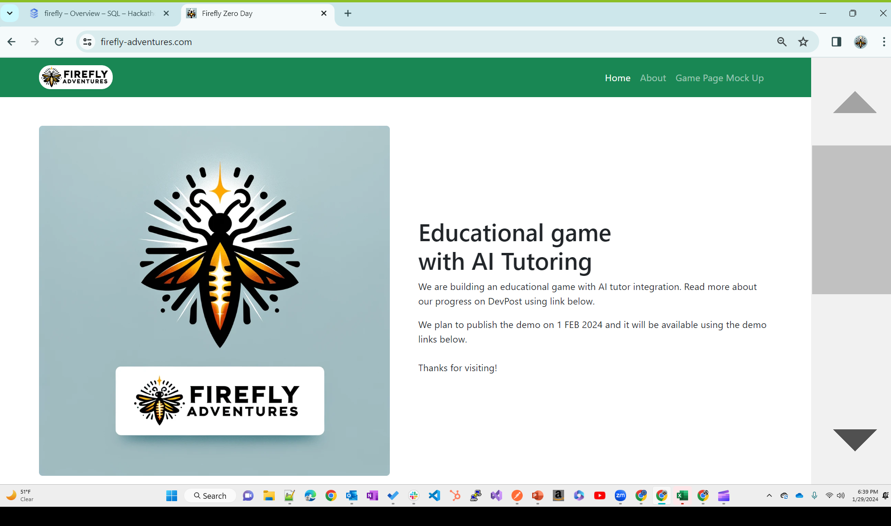

Slide 4
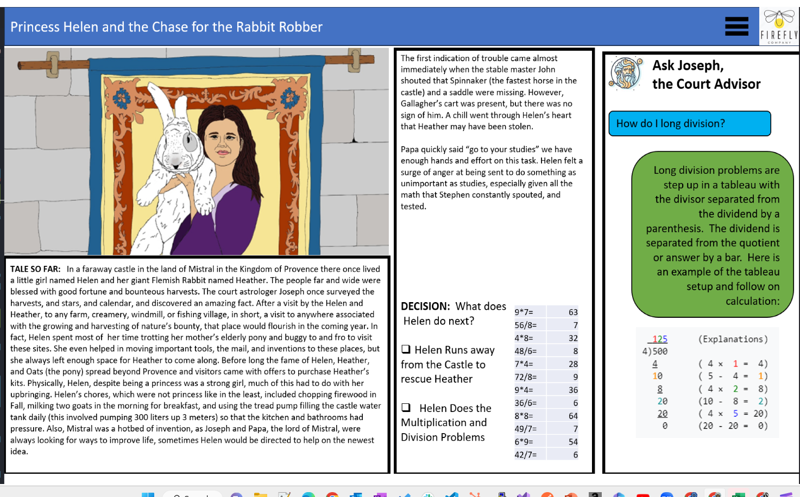

Slide 5
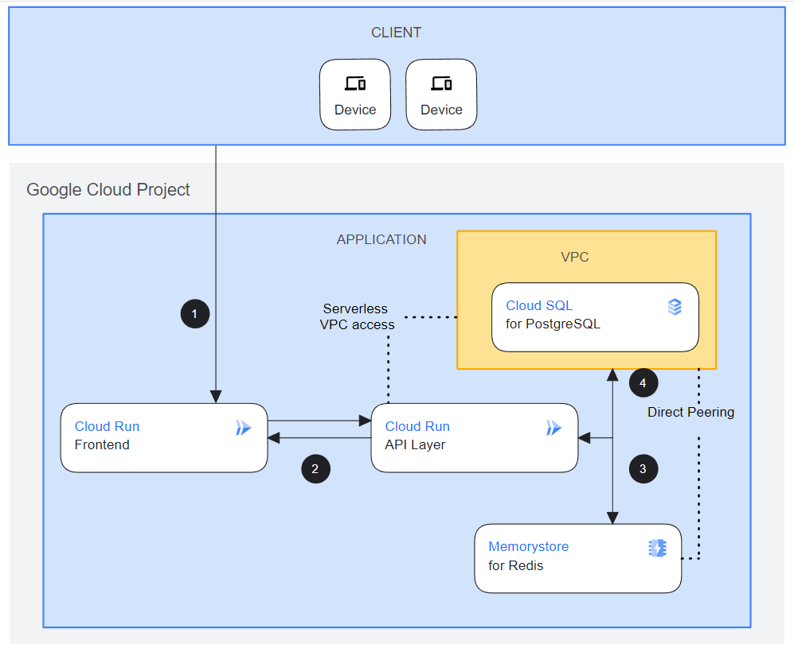
SYSTEM ARCHITECTURE
Built using React, .NET, Python, SQL
Designed to use Google Gemini
Designed for Google Cloud
Dynamic React webpage interaction with .NET and Python APIs
Cloudflare
Static Front
1A
MS SQL Server
Local Development
1B
Github
2A
Mid-Tier
.NET/C#
NEXT
Extend multimodal interaction with Gemini
Build out administrative aspects of the App, Google Identity, etc
2B
Cloud Run
API Layer
Mid-Tier Python
Cloud Storage
Gemini

Slide 6
SYSTEM ARCHITECTURE REFERENCES
(Github Organization and Repo Guide)
https://github.com/FireflyAdventures
PLAN, CODE TALKS
(1) 00-devops-documents = Concept and working documents
FRONTEND
(1A) 03C-fe-minimalist-static-CF = Website for home & static code
(1B) 03B-fe-react-dynamic = Website for database & AI dependent code
MIDTIER
(2A) 02B-mid-dotnet-julian = .NET/C# Midtier
(2B) 02B-mid-python = Python Midtier
BACKEND
(4) 01A-be-sqlserver = SQL database scripts
STATIC WEBPAGE
www.firefly-adventures.com
Cloudflare
Static Front
1A
MS SQL Server
1B
2A
Local Development
Github
Mid-Tier
.NET/C#
2B
Cloud Run
API Layer
Mid-Tier Python
GOOGLE CLOUD PLATFORM THREE TIER PROJECT:
https://console.cloud.google.com/home/dashboard?project=sincere-pen-411305
Cloud Storage
Gemini

Slide 7





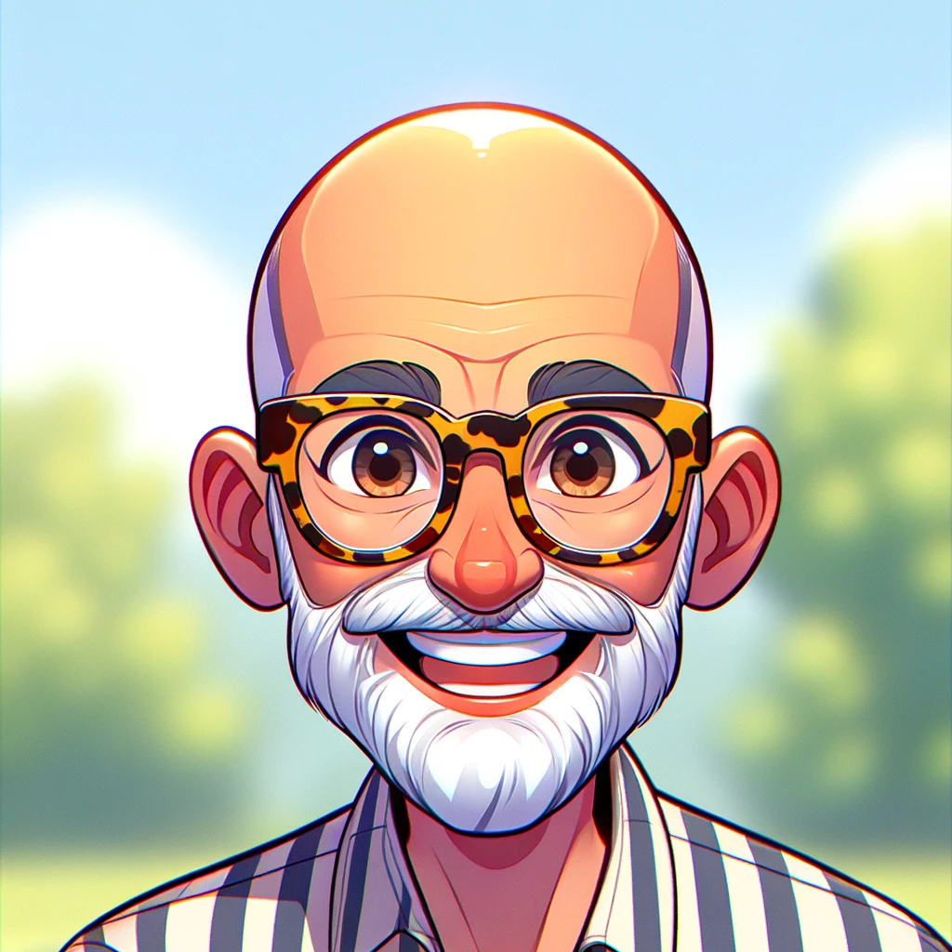

Thanks for Watching!
Find Team Firefly members at www.firefly-adventures.com
Jordin Camp
Jonathon Gonzalez
Abraham Ruelas
Sandy Saevang
Julian Smith
Thane Thompson
William Wold

